Slide 1
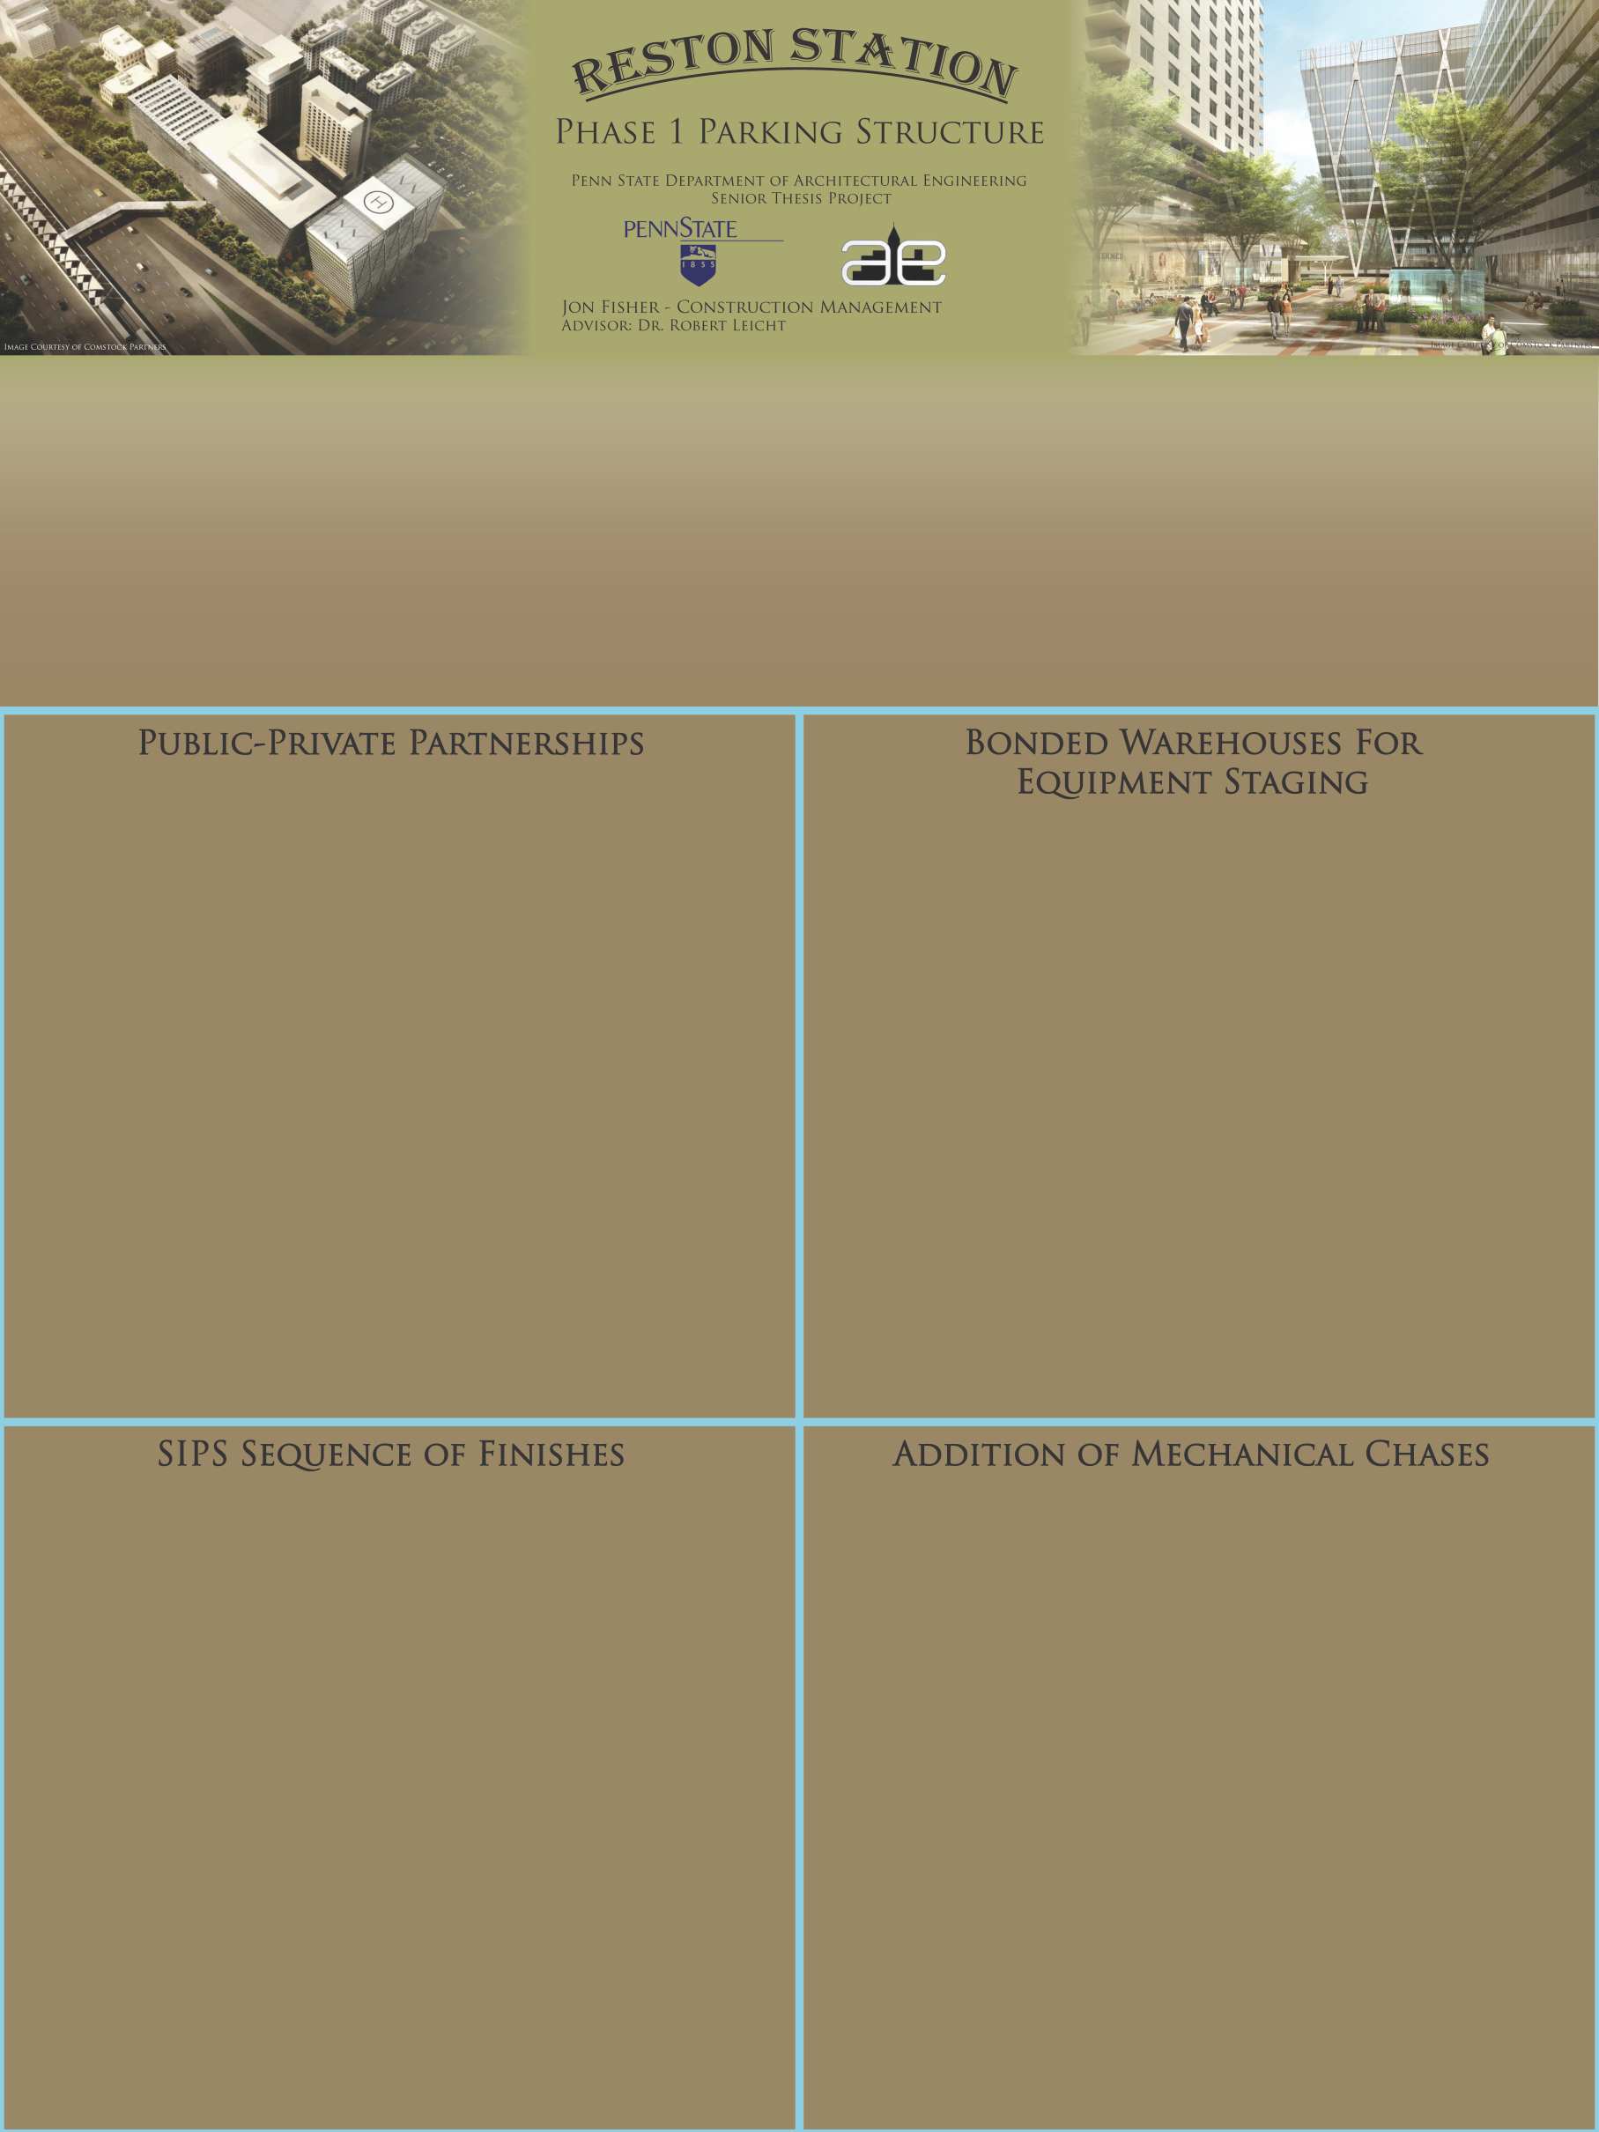
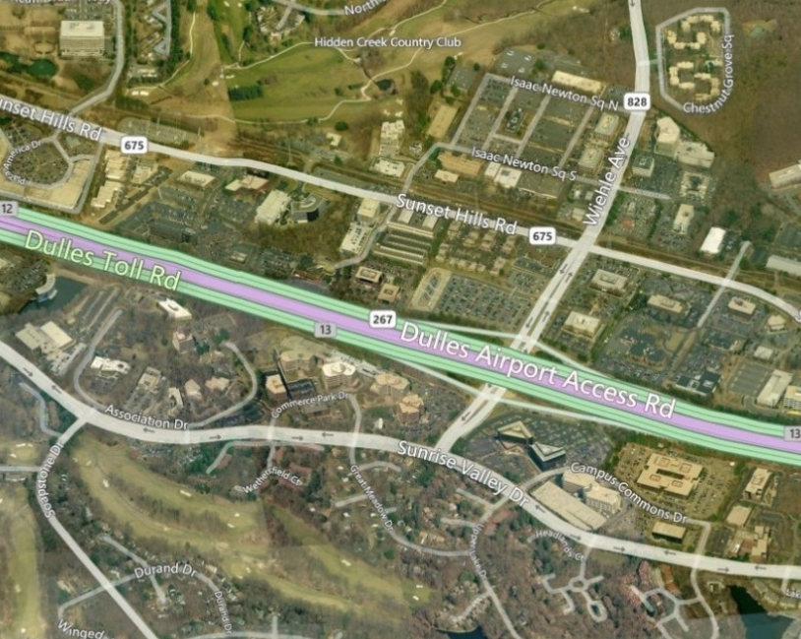
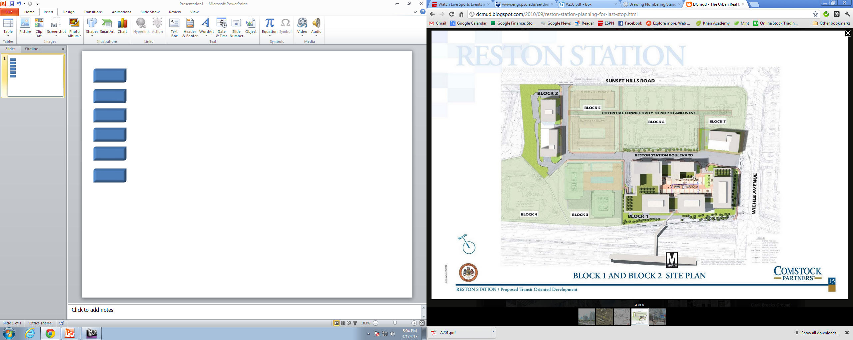



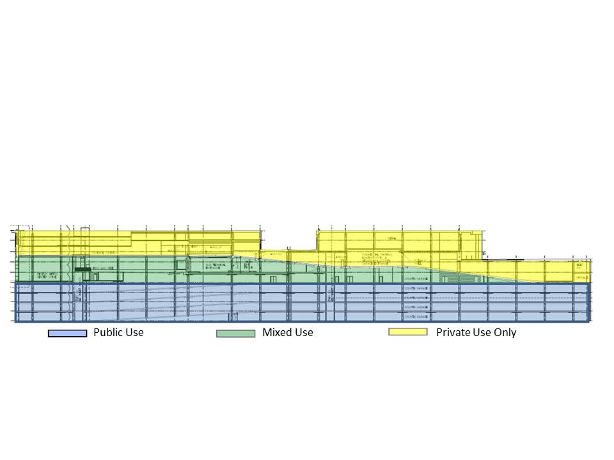
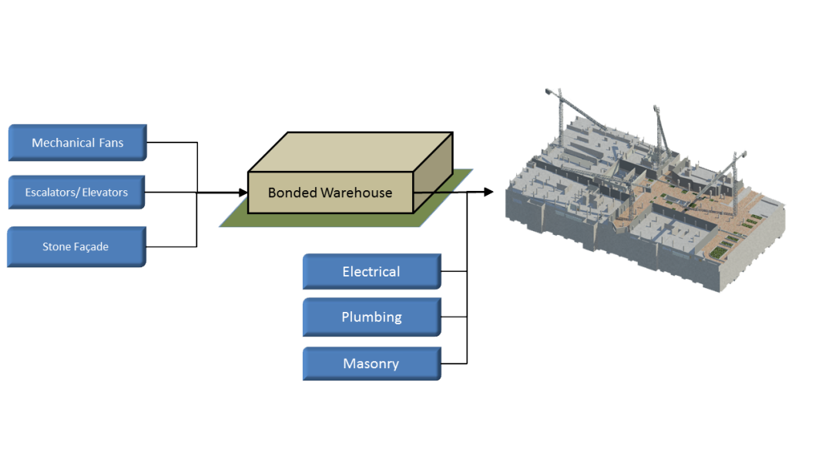
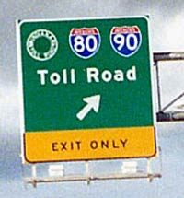
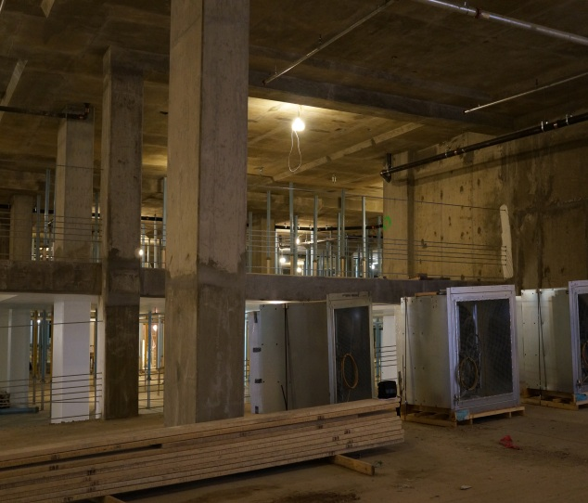
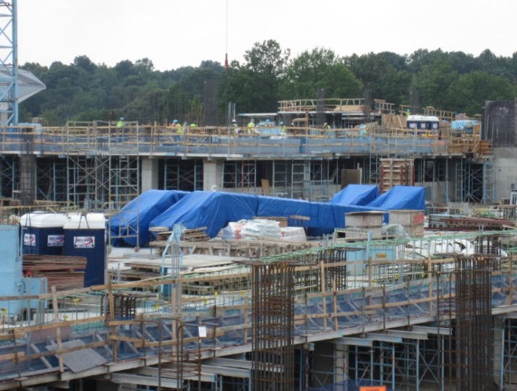
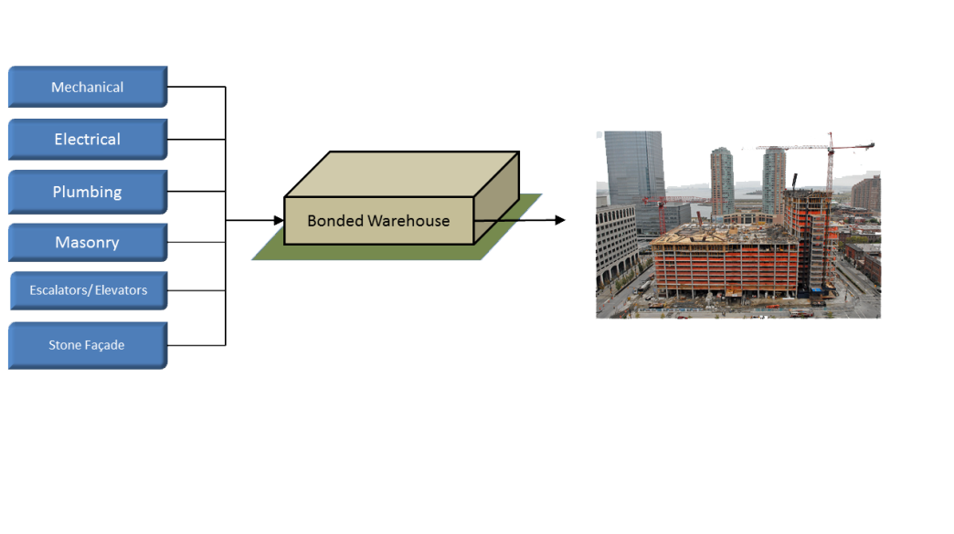
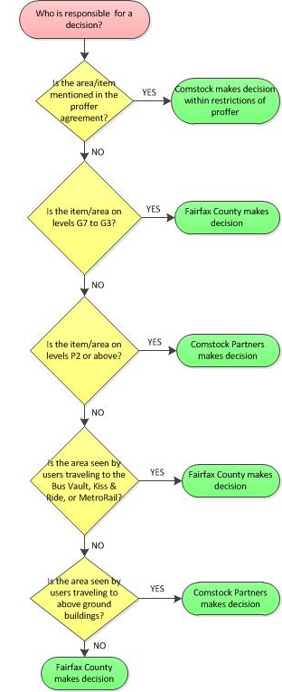
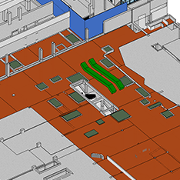
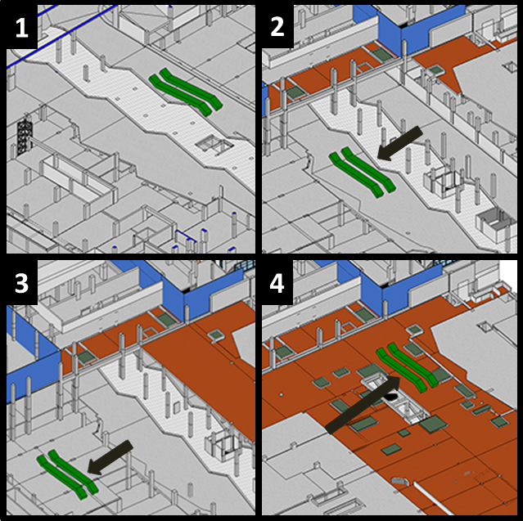
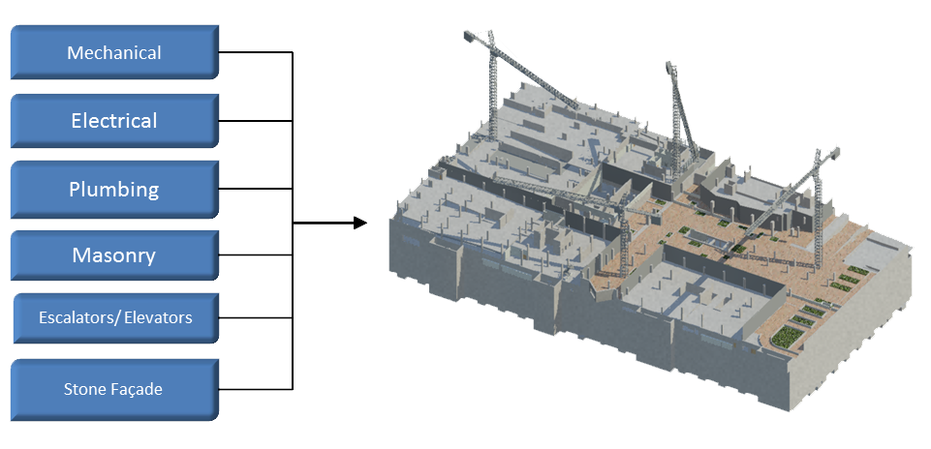
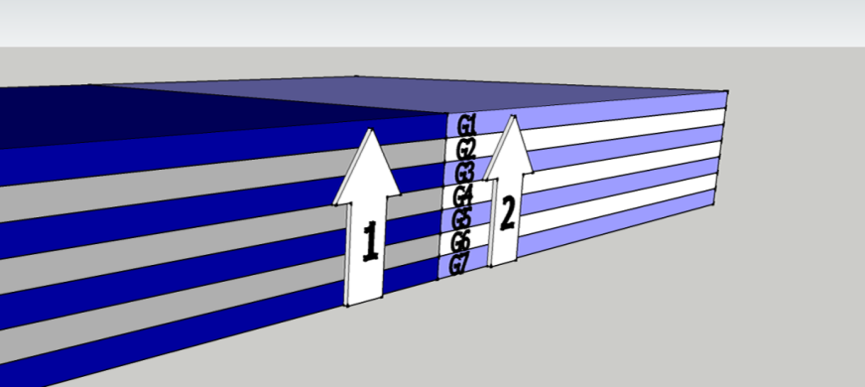
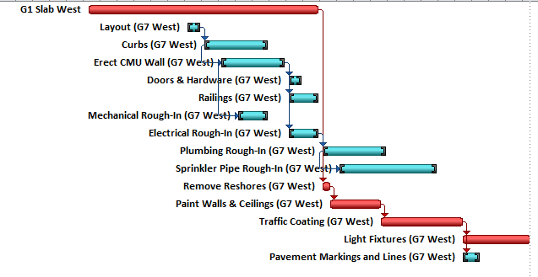
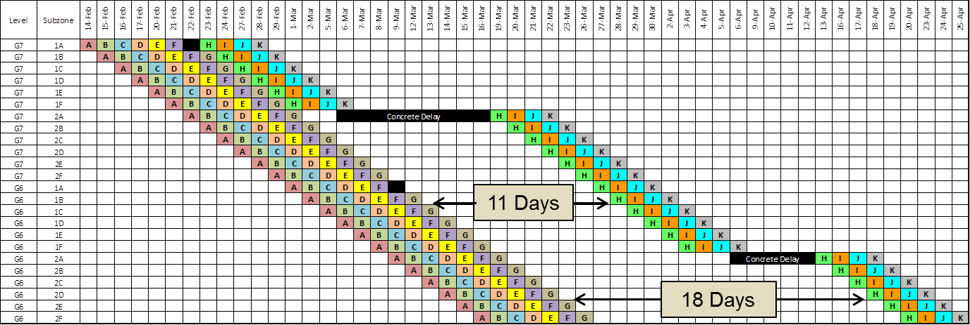
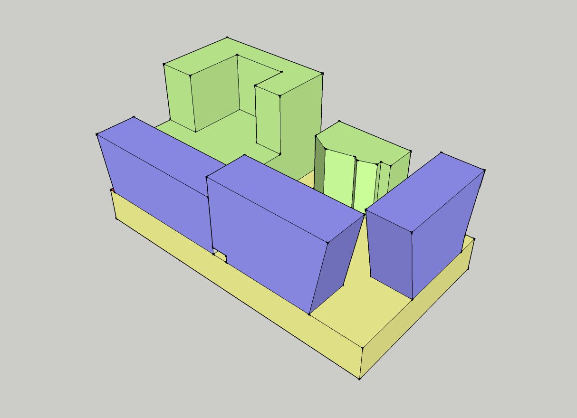
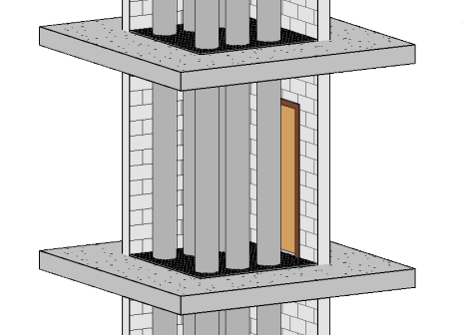
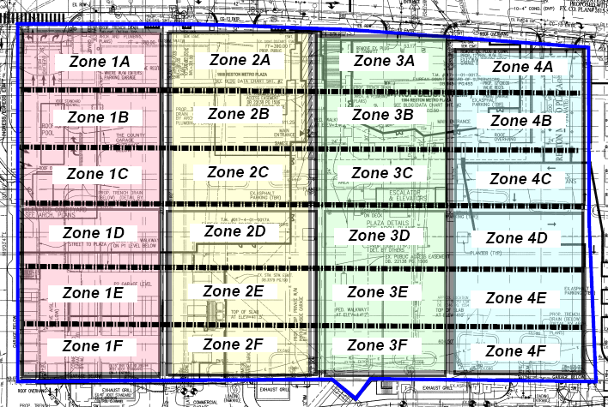
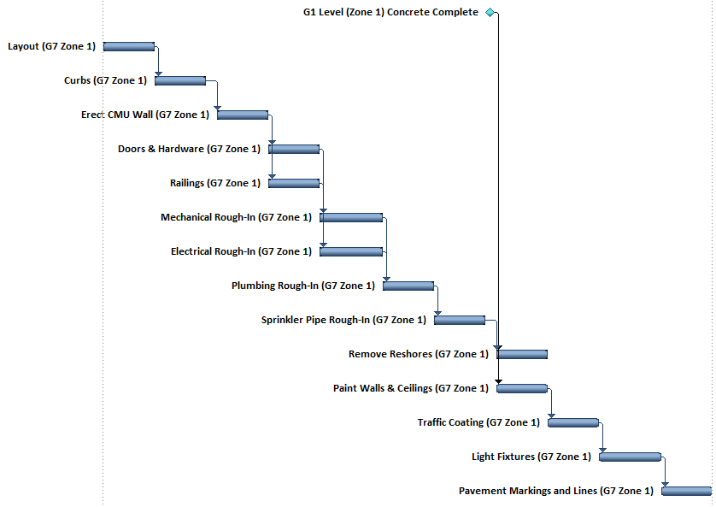
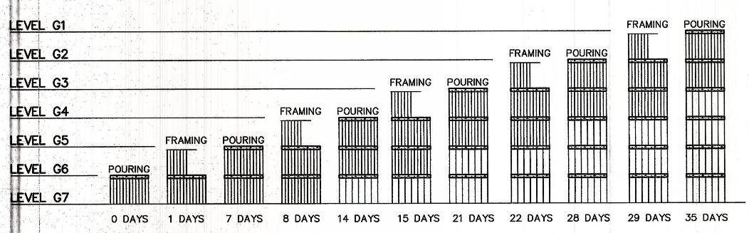
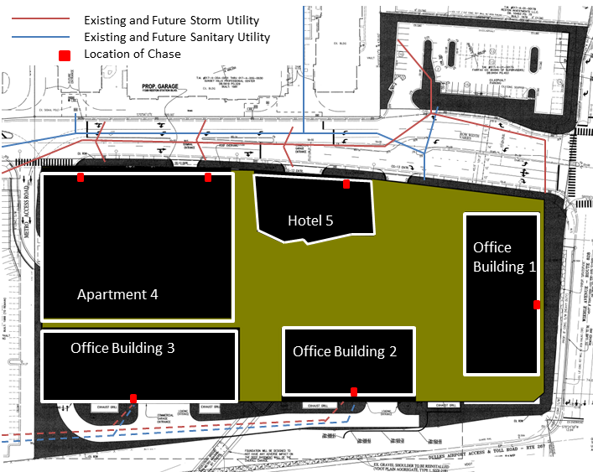
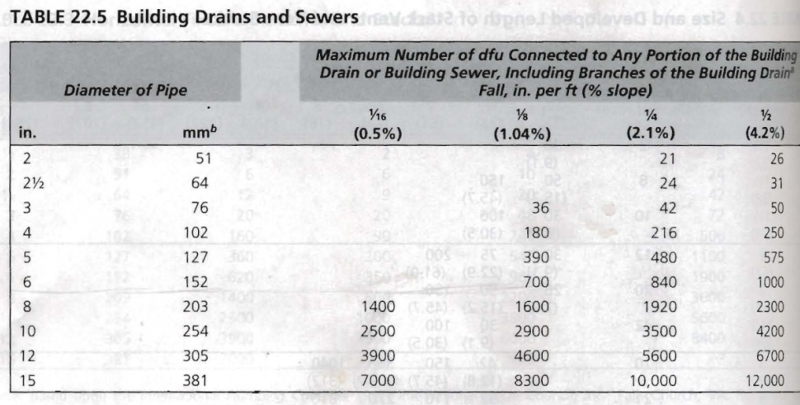
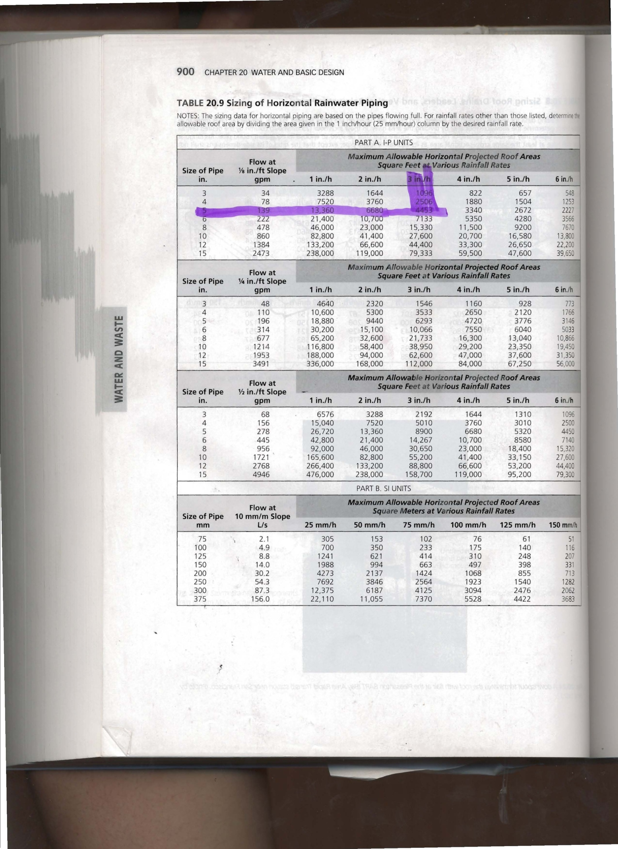
Building Statistics
Overview
Location | Reston, Virginia
Size | 1.3 Million Square Feet
Function | Commuter Parking for Metro Silver Line
Schedule Duration | 27 Months
Cost | $92 Million
Delivery Method | GMP with CM at Risk
Owner | Fairfax County & Comstock Partners
Development Associated with Dulles Corridor Metrorail Project (Silver Line)
7 Underground Levels of Parking Adjacent to New Wiehle Avenue Station
Future Development Plans Include the Construction of 3 Office Buildings, an Apartment, and a Hotel Above the Underground Garage
Public-Private Partnered Ownership Between Fairfax County and Comstock Partners
When the government and private sector work together
Example
The construction of roads comes at a heavy cost to public infrastructure departments but by incorporating another private investor and sharing toll revenues a win-win situations is discovered!
Challenges with Dual Owner Decision Making
Decision making issues arose in shard area of garage
Both owners were cautious of making decisions in areas of the garage that were shared by both parties
Solution:
Decision Making Flow Chart
Seeking to keep equipment safe from damage through the use of off-site bonded warehouses.
At Reston Station
140 fans, 2 escalators, and 100,000 SF of stone facade all stored on site in close proximity to active construction.
Temporary Use for Some Items
Protects valuable long lead items from damage
Month-to-month storage fees, transportation, and insurance costs associated
Good for site with some restriction
Long-Term Use as Delivery HUB
All items distributed through warehouse
Leasing, added staff, and bonding costs associated
Could be used when required or for significantly restricted sites
The Reston Station Partnership
Virginia Department of Transportation funds were allotted to the development along the Silver Line Metrorail Project.
Fairfax used these funds to plan and construction a 2300 space underground parking structure.
Under the Virginia Public-Private Partnership Act Fairfax was able to partner with Comstock in the construction of the garage leading up to future developments led by Comstock alone.
The cost of construction was shared by both parties in line with the ratio of public to private parking spaces available in the garage.
Change in Escalator Storage due to Concrete Design Delay
Planned Actual
Comparing Financial Impact
Aug. 2, 2012
Aug. 2, 2012
Sept. 17, 2012
Per Month Comparison of Bonded Warehouse Use
Scenario | Time Span (mo.) | Cost | Cost/Mo
Warehouse Leasing | 36 | $ 1,718,039.48 | $ 47,723.32
Short Term Warehouse Space Usage | 6 | $ 36,236.00 | $ 6,039.33
Nov. 19, 2012
Dec. 3, 2012
Conclusions
Reduces risk of damaging equipment stored on site
Accelerates subcontractor cash flow by allowing for slightly earlier delivery and billing of materials
Reduces traffic on site because separate subcontractor/supplier trucks can be consolidated into fewer shipments.
Leasing a warehouse is significantly more expensive than utilizing a logistics service. Therefore it was recommended that a month-to-month use of warehouses might be beneficial to Reston Station but a long term lease was cost prohibitive.
Conclusions
Partnerships are a great way of saving public funds but due to their very limited use in building construction their use needs to be studied closer before widespread use in our industry.
Key example of a possible pitfall is in the construction of the L:ong Beach Courthouse in which the public entity was forced to halt efforts on 23 other projects due to funding source complications.
Government’s role in partnerships also varies significantly between different levels and state to state.
Advantages of Public Private Partnerships
Public Owner | Private Owner
● Reduced Cost | ● Operation in New Markets
● Delivery Method Freedom | ● New Revenue Opportunity
● Possible Increase in Revenue | ● Government Relationship
● Increased Efficiency
The Traditional Method of Material Delivery
All material brought directly to site from sub or supplier
Forced to find space amid active trade activities
Good in a project with a lot of site freedom and flexibility
Original Sequence
Accounting for Reshores
Design Coordination Complications
Design of the Chases
6’x8’ chase with CMU wall
Outward swinging door and steel grating for access
Separates garage by east and west and by floor
Entire West portion completed first to align with concrete progress
Each area = 99,000 SF
Reshoring requirements limited progress of finishes
Structural breadth to reduce requirements from 2 framed with 4 shored to 2 framed with 2 shored slabs.
Breadth showed that a 10” slab with 5.5” drop panel is sufficient for a 2+2 shoring scenario
5.5” drop panel allows for a piece of dimensional 2x6 lumber to be used in forming which saves labor costs.
Architect - Hickok Cole
Structural - Structura
MEP - Hoffman Borowski
Architect – Davis, Carter, Scott
Structural – Luis Fernandez
MEP – Jordan & Skala
Architect – Murphy/Jahn
Structural – Thorton Thomasetti
MEP – GHT Chartered
SIPS Re-sequence
3 separate design teams involved in various phases of Reston Station site development
Due to fast-track design and construction on the garage, complications existed with penetrations for drain pipes
Location of Chases
Pipe Sizing for Sanitary and Storm Drains
Redefined smaller finish zones and sequence to facilitate 1 subzone/activity/day productivity rate
Also follows concrete progress closer
Pipes were sized using the International Plumbing Code and International Building Code to make determinations on building occupancies and number of plumbing fixtures
The assumption that each building system consolidated to 1 pipe was used with the exception that the apartment building needed an additional shaft due to sanitary pipe runs and ceiling plenum depth concerns.
Conclusions
Matrix Schedule of SIPS Sequencing
SIPS Schedule Results
Finish Scenario | Start | Finish | Duration | Saved Duration | Days Complete Before BL Finish | Cost Increase
Baseline Schedule | 14-Feb-12 | 5-Feb-13 | 256 | - | - | $ -
"Perfect" Matrix | 14-Feb-12 | 18-Oct-12 | 178 | 78 | 78 Days | $ -
SIPS w/ 4+2 Shoring | 14-Feb-12 | 13-Nov-12 | 196 | 60 | 60 Days | $ -
SIPS w/ 2+2 Shoring | 2-Jan-12 | 10-Oct-12 | 203 | 53 | 85 Days | $ 200,000.00
Location on perimeter allows for simplified connection to existing and future utility lines
Locations are in areas convenient to future stairwells and elevator shafts
Garage Activity Productivity Rates
Schedule Indicator | Activity | Baseline Duration (Days) | Productivity (SF/Man/Day) | SIPS Subzone Area | # of Workers (SIPS)
A | Layout | 5 | 9900 | 8250 SF | 2
B | Curbs | 20 | 413 |  | 20
C | CMU Walls | 20 | 620 |  | 14
D | Doors & Hardware | 5 | 9900 |  | 2
 | Railings | 10 | 3300 |  | 3
E | Mech Rough In | 10 | 2475 |  | 4
 | Electrical Rough In | 10 | 1650 |  | 6
F | Plumbing Rough In | 20 | 495 |  | 17
G | Sprikler Rough In | 30 | 825 |  | 10
H | Remove Reshores | 3 | 8250 |  | 4
 | Paint Walls and Ceilings | 15 | 660 |  | 13
I | Traffic Coating | 24 | 1094 |  | 8
J | Light Fixtures | 20 | 825 |  | 10
K | Pavement Markings | 5 | 3300 |  | 6
Redefined crew sizes based on baseline productivity rates
Produced a matrix schedule comprised of 168 zones over 178 days
Concrete reshore requirements impacted continuity of sequence
85 days saved in the finish sequence with slab redesign and SIPS sequencing
Redesign would cost $200,000 in concrete which is equivalent to $2,350/saved day in the schedule
$2,350/day compared to an approximate $10,000/day in liquidated damages indicates the redesign and SIPS sequence is in owners financial interest
Conclusions
Cost of chases is 9 times more expensive than core drilling slabs at a later date
Locations of slabs would eliminate 10 public and 12 private parking spaces which results in lost revenue
Not a recommended solution and more analysis is needed regarding design coordination on site

